Slide 1



Module: <IT Systems & Networks>
Module Project
<Principles and Design of Networked Systems>
Sebastian Seth R. Escarro
bdse-0922-118
Start Date: | 7/20/2024 | End Date: | 11/9/2024
Submission Date: | 11/11/2024 | Presentation Date: | <insert date>

Slide 2
Content
S. No. | Description
01 | Project background, objective & deliverables
02 | List of software used
03 | Network Types
04 | Network Standards
05 | Impact of Network Topology, Communication and Bandwidth Requirements
06 | Common Networking Principles
07 | Network Server Types
08 | Network Design for project
09 | Maintenance Schedule
10 | Test Plan
11 | Improved Network Design based on feedback
12 | Implementation of Network Design
13 | Implementation of Test Plan
14 | Evaluation

Slide 3
Content
S. No. | Description
15 | Project Milestones & Tasks
16 | Milestone Feedback & Action taken
17 | Modifications Made based On Feedback
18 | Project Results
19 | Proposed Improvements

Slide 4
1. Project background, objective & deliverables
Swift & Bacon Publishers (SBP) Ltd is a medium-sized company specializing in the publication of scientific and technical books and journals. SBP operates from two office buildings and supports a hybrid working model, allowing employees to work both remotely and on-site. The organization consists of four subject-specific Publishing Teams, each managed by a Publishing Team Leader (PTL) and supported by up to 20 Publishing Editors (PEs). SBP's network infrastructure includes secure servers for managing manuscripts and publishing content, with a need to maintain high security and efficient data handling.
Given the company's recent shift towards hybrid working, SBP plans to close one office building and reconfigure the remaining building to support both on-site and remote work. This reconfiguration involves setting up a secure, efficient, and robust network infrastructure that caters to the needs of employees working from home and those who choose to work from the office.

Slide 5
1. Project background, objective & deliverables
Requirement Specification
Network Infrastructure (Top Floor, Middle Floor, Ground Floor)
Remote Work Capabilities: Company Issued Laptop and VPN Server
Security
Connectivity
Data Management
Employee Management
Project Objective
Improve Remote Working
Reconfigure Infrastructure
Upgrade Network
Better Security
Networking Solutions

Slide 6



2. List of software used

Slide 7
3. Network Types
Network Types | Benefits | Constraints | Examples
Wired | -Stable and reliable connection -High speeds with low latency -Less susceptible to interference | -Limited mobility -Requires physical cables -Higer costs in a complex environment | -Ethernet (LAN) -Fiber Optic Networks
Wireless | -Great mobility and flexibility -Quicker to deploy -No cables | -Might be affected by interference -Slower compared to wired -Possible security concerns | -Wi-fi -Cellular Networks
Hybrid | -Combines advantages of wireless and wired -More scalable and flexible design | -Complex network management -Expensive to deploy and maintain -Integration issues | -Corporate Networks (wired LAN and wireless access) -Home networks (Ethernet and Wi-fi)

Slide 8
4. Network Standards
Network Standards | Benefits | Constraints | Purpose | List of Layers
OSI Model | - Provides a comprehensive framework for network architecture - Helps in troubleshooting and standardizing protocols - Easy to understand and teaches network fundamentals | - The model is theoretical and not always practical -Implementation can vary | - To standardize network functions and facilitate interoperability between different systems | 1. Physical 2. Data Link 3. Network 4. Transport 5. Session 6. Presentation 7. Application
TCP/IP Model | - Practical and widely used for real-world networks - Simplified compared to OSI - Focuses on protocols that are in use today | - Less granular than OSI - Can be less helpful for detailed network troubleshooting | - To define the protocol suite used for communication over the internet | 1. Link 2, Internet 3. Transport 4. Application
802.x | - Defines various aspects of local area network (LAN) standards - Ensures compatibility and interoperability - Supports high-speed networking | - Each standard has different applications and may not be compatible with each other - Implementation complexity | - To provide standards for different types of network interfaces and technologies | - Specific layers vary by standard, but commonly include physical and data link layers. Examples: - 802.3 (Ethernet) - 802.11 (Wi-Fi) - 802.15 (Bluetooth)

Slide 9
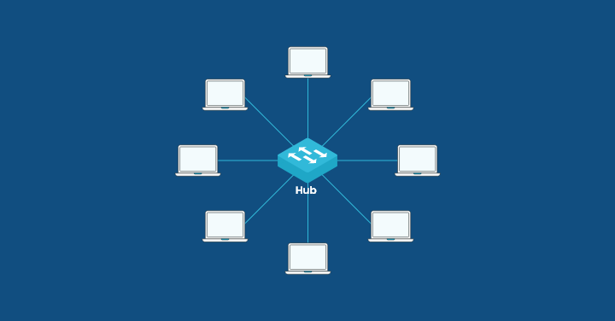
5. Impact of Network Topology, Communication
and Bandwidth Requirements
Network Topology
Network topology defines the arrangement of devices and connections within a network. It directly influences data flow, performance, and security.

Slide 10
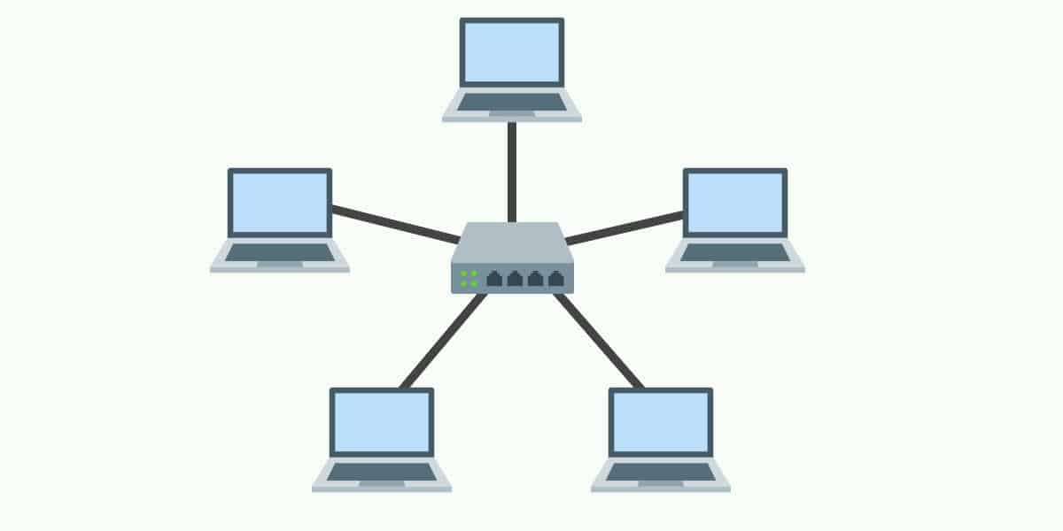
5. Impact of Network Topology, Communication
and Bandwidth Requirements
Star Topology: In a star topology, all nodes are connected via a central hub or switch

Slide 11
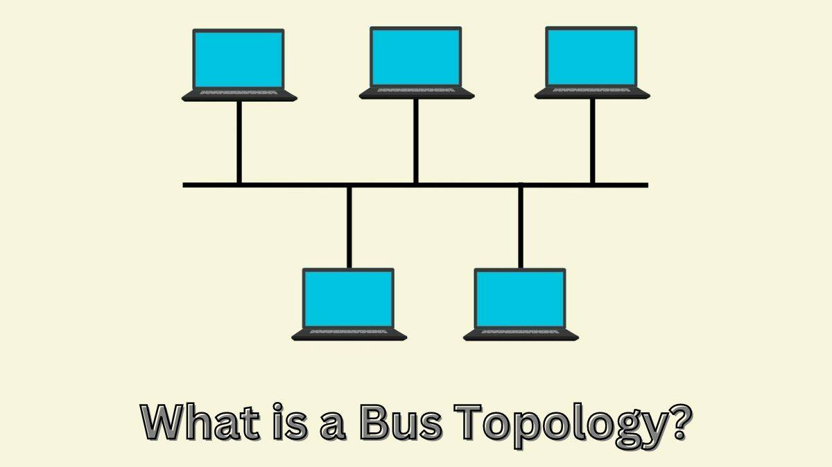
5. Impact of Network Topology, Communication
and Bandwidth Requirements
Bus Topology: Devices are connected via a single central cable. Like a bus going from point a to point b

Slide 12
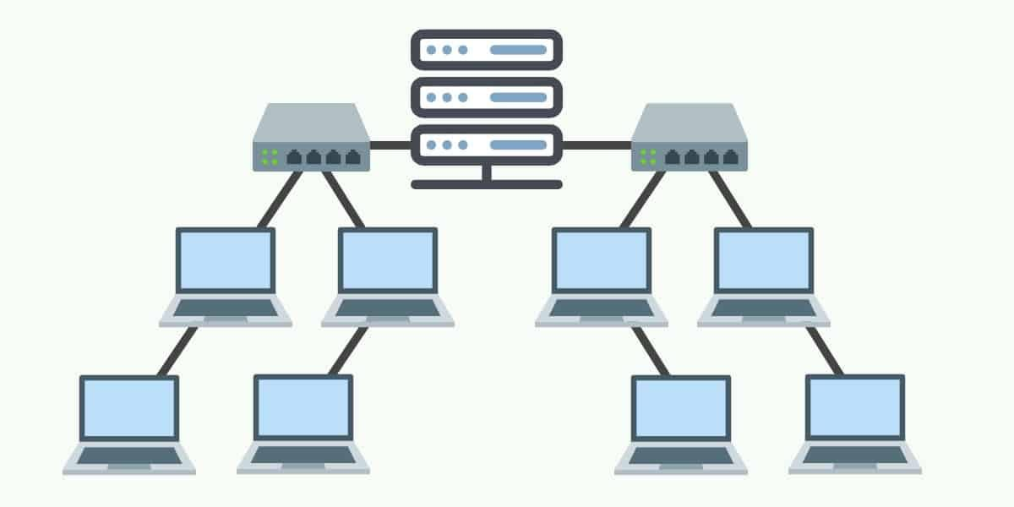
5. Impact of Network Topology, Communication
and Bandwidth Requirements
Tree Topology: Structured like a tree where a root node branches out into multiple nodes

Slide 13
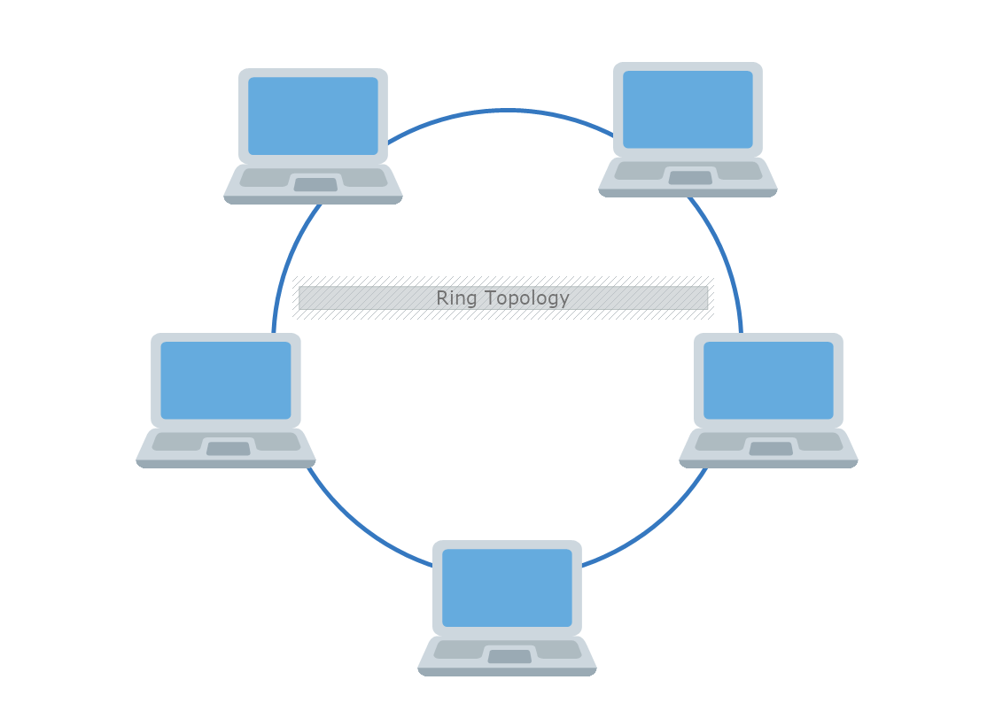
5. Impact of Network Topology, Communication
and Bandwidth Requirements
Ring Topology: Devices form a loop making a circle

Slide 14

5. Impact of Network Topology, Communication
and Bandwidth Requirements
Communication - Communication ensures seamless data exchange between devices and users within a network. It’s like the network’s “language” that allows devices to talk to each other effectively.

Slide 15
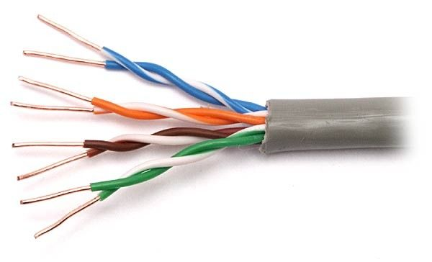
5. Impact of Network Topology, Communication
and Bandwidth Requirements
Twisted Pair Cables: Twisted pair cables consist of wires twisted together in pairs. They are cost-effective, easy to install, and suitable for short distances.

Slide 16
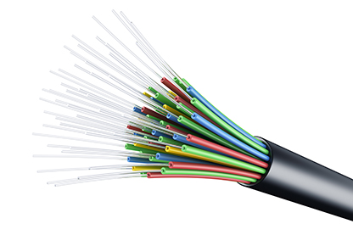
5. Impact of Network Topology, Communication
and Bandwidth Requirements
Fiber Optic Cables: Fiber optic cables use light signals for data transmission. They offer high performance, immunity to electromagnetic interference, and long-distance connectivity.

Slide 17
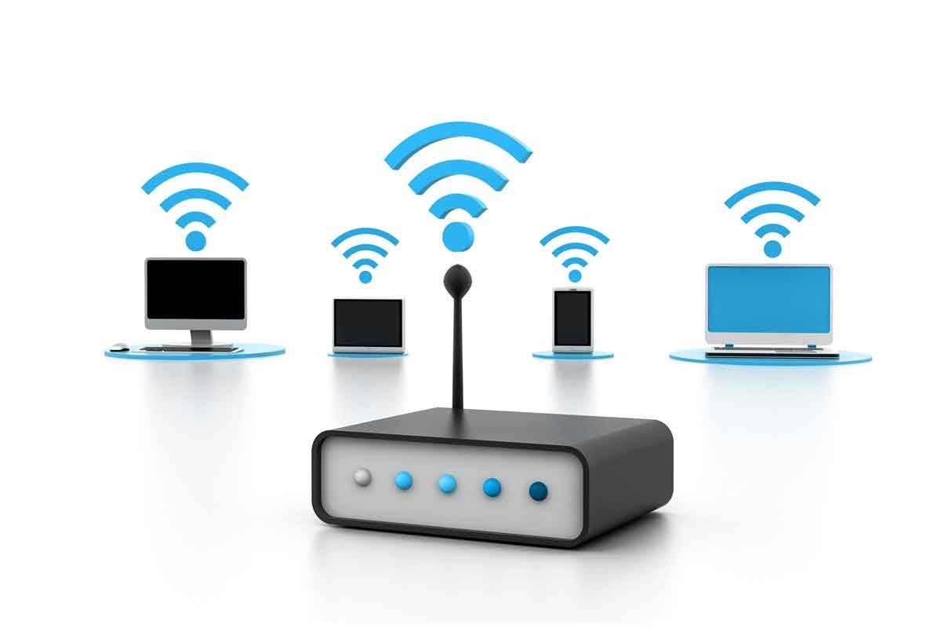
5. Impact of Network Topology, Communication
and Bandwidth Requirements
Wireless Networks: Wireless networks provide mobility and ubiquitous access. They allow devices to connect without physical cables, making them versatile for various scenarios.

Slide 18

5. Impact of Network Topology, Communication
and Bandwidth Requirements
Bandwidth Requirements
Bandwidth refers to how much data can be sent or received through a network link in a given time. It’s like the network’s “highway capacity”—enough bandwidth ensures smooth data flow, while insufficient bandwidth leads to congestion.

Slide 19


6. Common Networking Principles
Scalability: A network must be able to handle growth like if new devices are added or if new users are using it.
Security: Protecting the network from cyber threats is essential. Security measure like encryptions, firewalls or protocols must be used in order to ensure safe data travel.

Slide 20


6. Common Networking Principles
Redundancy: Networks must have a backup system in place just in case some unfortunate circumstances happen.
Reliability: The network must provide a consistent and stable connection with minimal outages.

Slide 21


6. Common Networking Principles
Bandwidth Management: Ensuring proper bandwidth for all data demand is crucial.
Latency and Throughput: Latency refers to delay while throughput refer to successfully transmitted data.

Slide 22
7. Network Server Types
Network Server Types | Operating Principle | Function | Impact
Routers | Operate at network layer | - Connect different networks - Route data packets between networks - Choose optimal paths for data transmission | - Enables communication between networks - Manages data traffic efficiently - Enhance connectivity to network
Switches | Operate at the data link layer | - Connect devices within a local LAN - Forward data based on MAC addresses - Improve network efficiency | - Facilitate device communication - Reduce unnecessary traffic - Enhance LAN performance
Firewalls | Operate based on predefined rules | - Control access for networks - Inspect packet headers and manage traffic - Blocks threats | - Protection from unauthorized access - Safeguard sensitive data - Prevent malicious traffic
Web Servers | Serve web content to clients | - Respond to HTTP requests - Host websites and web applications | - Efficient web page delivery - Enable online presence for businesses
File Servers | Store and manage files for network users | - Centralize file storage - Provide access control and permissions | - Facilitate collaboration - Ensure data consistency - Improve data security
Database Servers | Manage databases and handle queries | - Create, read, update, and delete data. - Handle transactions | - Optimize query performance - Ensure data integrity

Slide 23
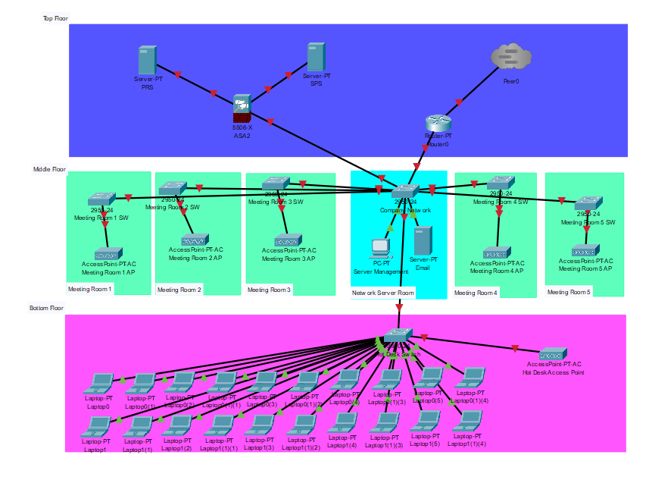
8. Network Design for project

Slide 24
9. Maintenance Schedule
No. | Equipment Description | Condition | Maintenance Frequency (days) | Description of Maintenance Activity | Assignee | Last Maintenance Date | Next Maintenance Date
1 | Public Repository Server | Good | 30 | Inspection, Security Check | Network Admin | 11/02/2024 | 11/09/2024
2 | Secure Publishing Server | Good | 30 | Content Review, Check Backup | Network Admin | 11/02/2024 | 11/09/2024
3 | Email Server | Good | 15 | Security Check, System Updates | Network Admin | 11/02/2024 | 11/09/2024
4 | Laptops | Fair | 90 | Inspection, Virus Check | Senior IT | 11/02/2024 | 11/09/2024
5 | Network Admin’s Pc | Good | 60 | Inspection, Check Updates | Senior IT | 11/02/2024 | 11/09/2024

Slide 25
10. Test Plan
Test Item | Test Data | Test Action | Expected Result
Topology | Test if topology is up and running | Routing tables ping requests | All devices are connected
VPN Test | Test if VPN configuration on laptops is running | Connecting VPN to servers and try to access them | Remote users should access internal resources
Access Control Test | Test if users have the proper roles and permissions | Attempt to access files with different roles | - Network Administrator should have full access to all server resources. -Publishing Editor and Publishing Team Leader should have limited or read-only access, depending on their roles. -Unauthorized access attempts should be denied, maintaining security policies.
Bandwidth Test | Test if multiple files load properly | Measure upload/download speeds between floors | Network should handle the file transfers smoothly with minimal speed drop.

Slide 26
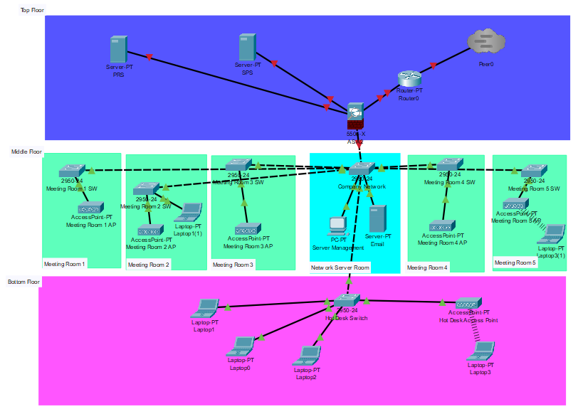
11. Improved Network Design based on feedback

Slide 27
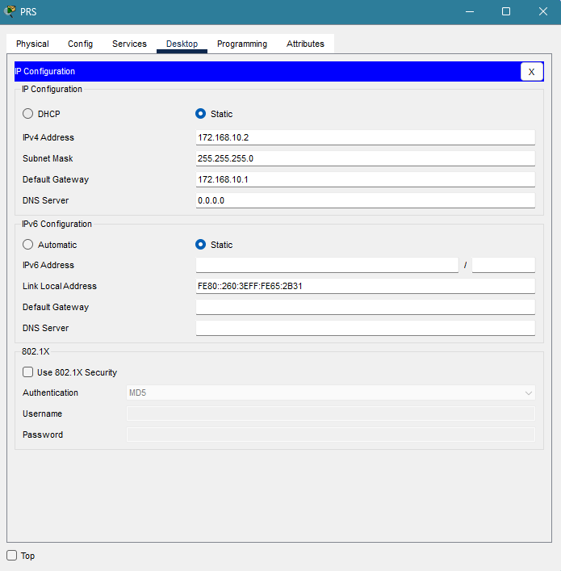

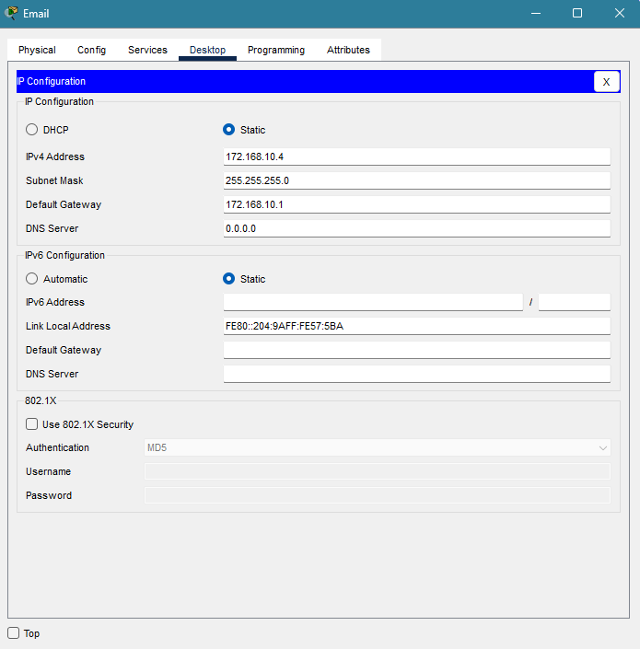
12. Implementation of Network Design

Slide 28
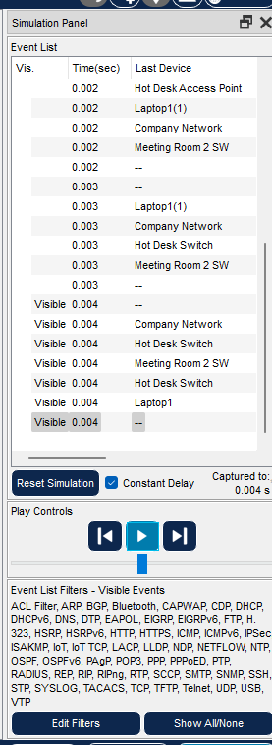
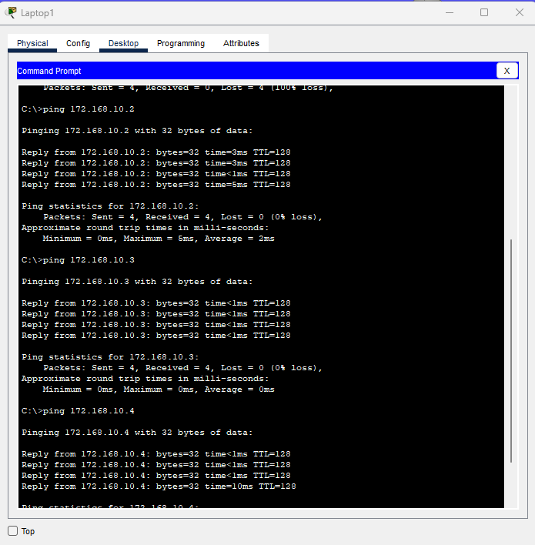
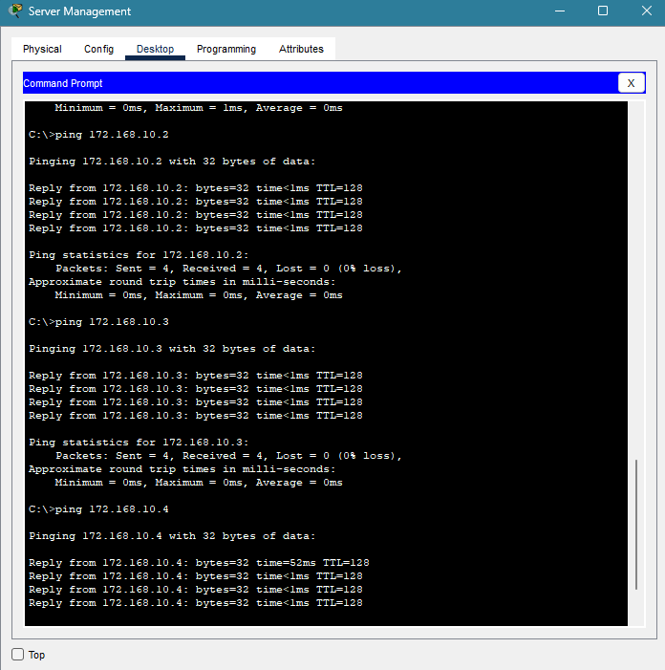
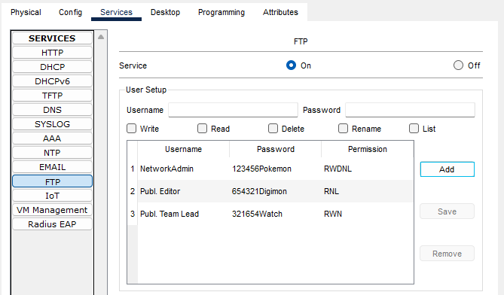
13. Implementation of Test Plan

Slide 29
14. Evaluation
The implemented network is designed to support a large, segmented office environment, with a clear separation of floors and departments. Each floor has a dedicated switch connected to a centralized router, which facilitates efficient data flow across the network and enables secure connections to essential services such as the PRS, SPS, and Email servers.

Slide 30
15. Project Milestones & Tasks

Slide 31

16. Milestone Feedback & Action taken
Project Milestone ID | Milestone Feedback received from Tutor / Learning Facilitator | Action Taken (Yes / No)
1
2
3

Slide 32
17. Modifications Made based On Feedback
Used copper cross-over wires to connect between switches

Slide 33
18. Project Results

Slide 34
19. Proposed Improvements

Slide 35
THANK YOU

